Slide 1


SQL Based Project-UK Train schedule
Presented By-Vaibhav Vitthal Joge

Slide 2

DATA SET INFO
ANALYZING FACTORS:-This Visualization is created based on the Train Arrival & Departure Station, Ticket Purchase Date & Time ,Ticket Class , Type of purchase , Payment Method, Ticket Price, Actual Arrival Time Factors.
OBJECTIVE:-We raised different type of queries through MySQL & analyze the data for predict the future issue.

Slide 3

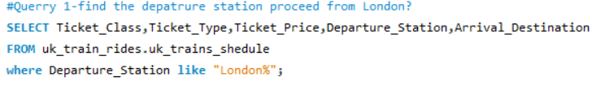
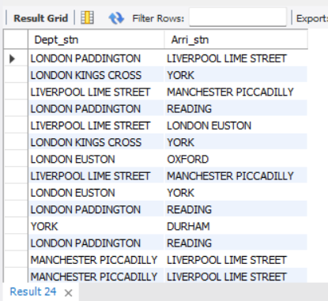
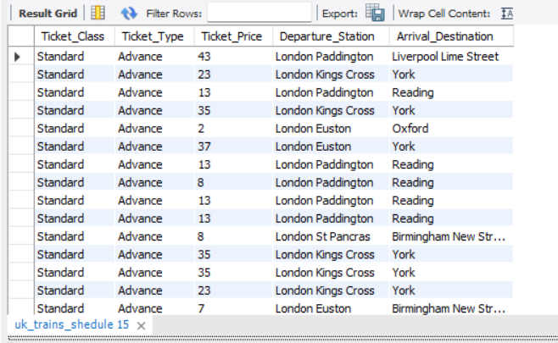
SQL Based Project-UK Train schedule
PRESENT IN UPPER CASE OF DEPT & ARRIVAL STATION.
FIND THE LIST OF DEPARTURE STATION PROCCED FROM LONDON

Slide 4


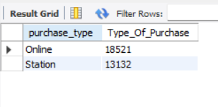
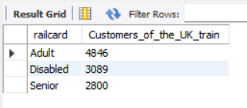
SQL Based Project-UK Train schedule
Which type of transection preferred by customer on high priority
Categories High Users train customers

Slide 5

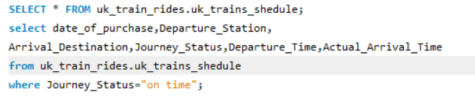
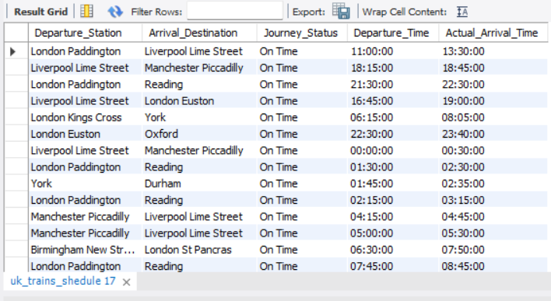
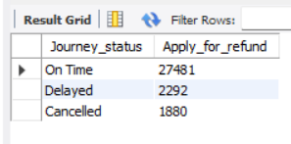
SQL Based Project-UK Train schedule
How Much customer Applicable for request refund money
Find the List of Departure & Arrival station which is to be on exact Time (On-Time) .

Slide 6
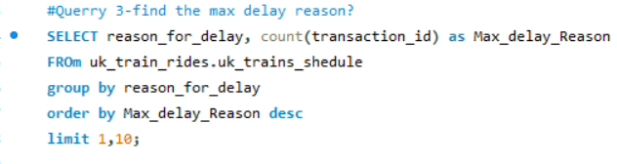
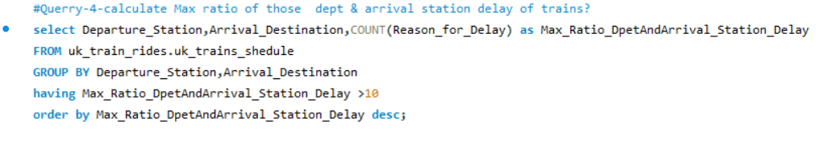
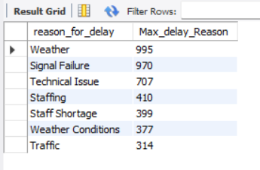
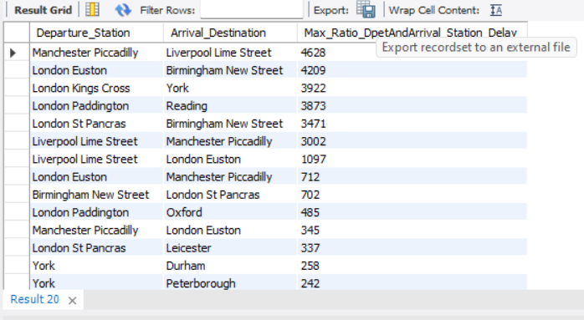
SQL Based Project-UK Train schedule
Identify the delay reason which occurred many time
Show those Dept & arrival station where to be maximum Delay Occurred.

Slide 7
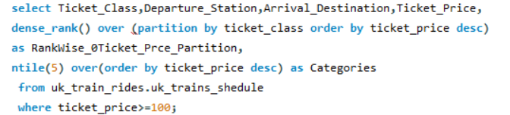
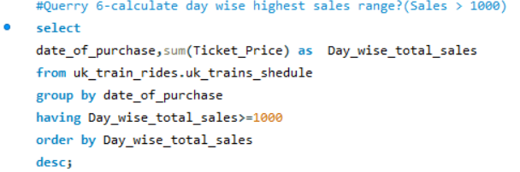
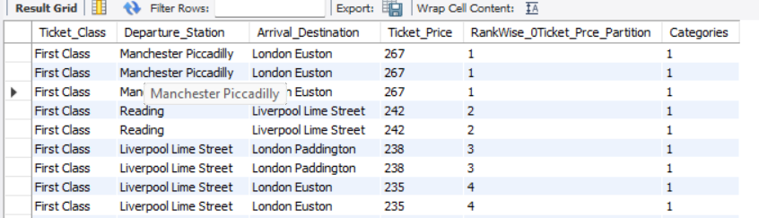
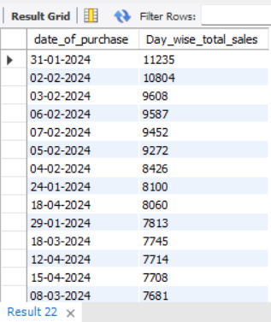
SQL Based Project-UK Train schedule
Identified Rank Wise Which tickets are sailed on high cost depends on Dept & arrival station & ticket Class (cost up to < 100).
Calculate day wise highest sales range(sales > 1000)

Slide 8
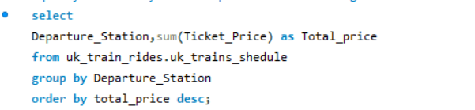
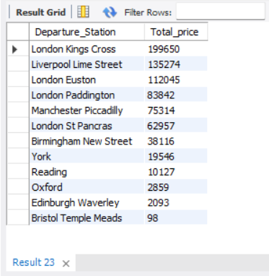
Identify which dept station generate high sales amount

